Slide 1
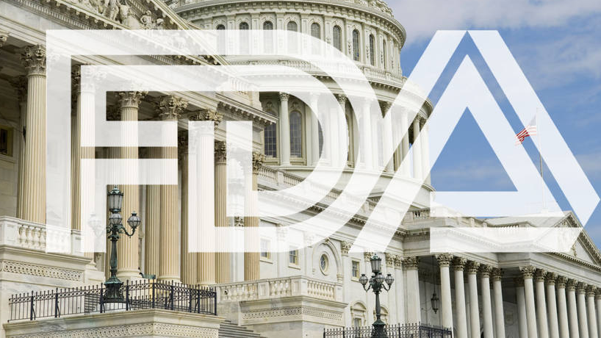
OneScan
Group 5 Zimo Zhou (1189792), Yaowen Mei (1177855)
https://www.cigaraficionado.com/article/lobbyists-increase-outreach-for-premium-cigar-exemption-19574

Slide 2
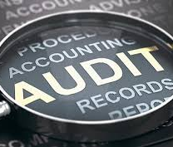
What and
Why
OneScan is an App is to help an auditor to conduct a more efficient and more convenient audit for a medical device factory or automotive parts factory.
Manufactories in North America are under strict regulation.
The auditors need a precise and efficient way to know:
What is the name of this device,
Has this device been calibrated before use,
How often should it be calibrated according to the standard operation procedure,
Where can I find the historical calibration record.
For these requirements, our app (Machine learning + Database) can easily provide the useful information.
Select from Album
Take a picture
Picture Clear
Deep Learning Recognition
Get Status from Database

Slide 3
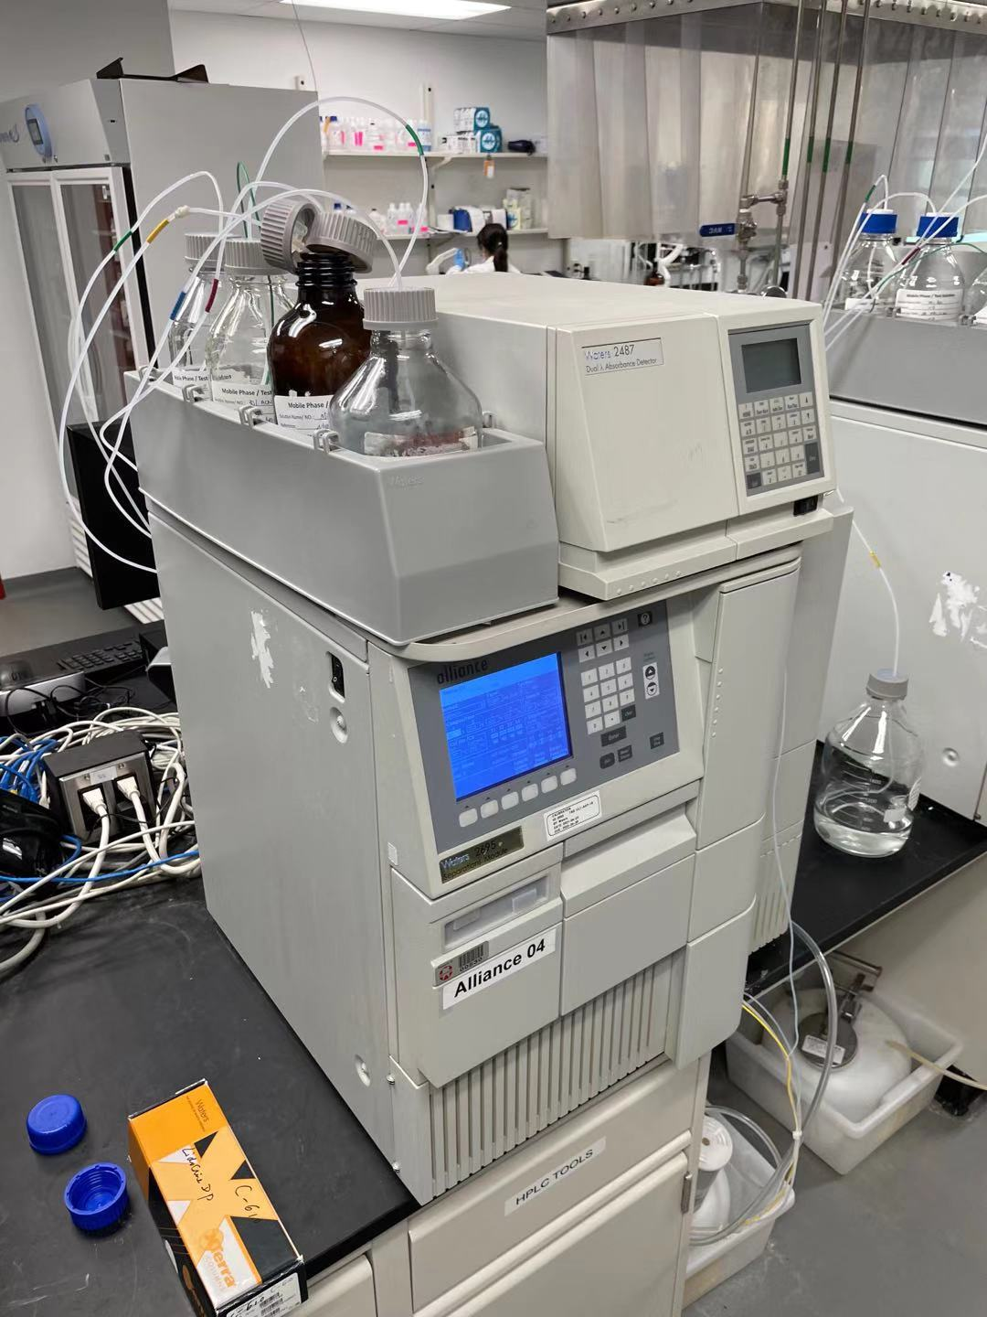
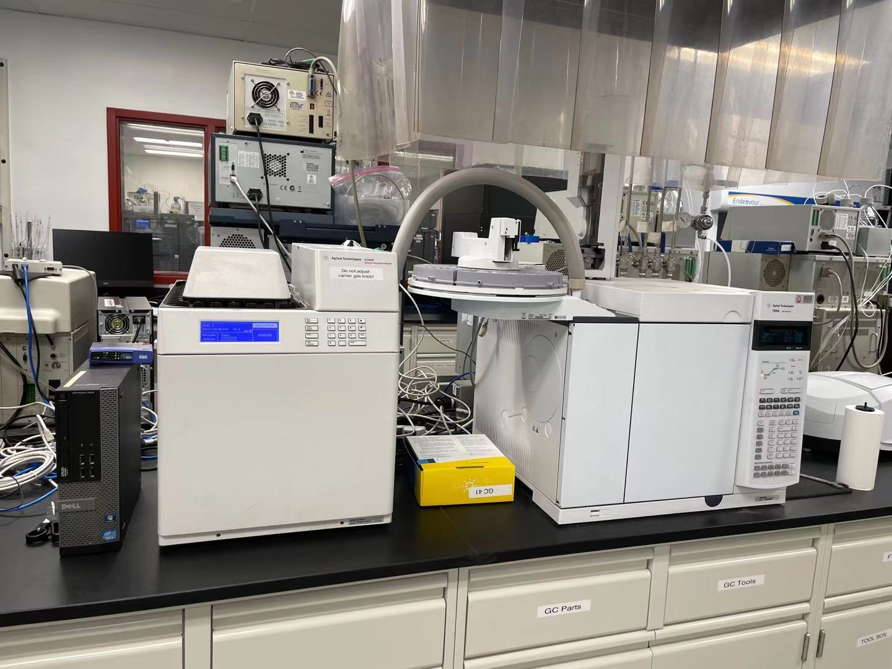
Analytical Chemistry 101
Gas_Chromatography (GC)
High-Performance Liquid Chromatography-(HPLC)
https://en.wikipedia.org/wiki/High-performance_liquid_chromatography
https://en.wikipedia.org/wiki/Gas_chromatography

Slide 4
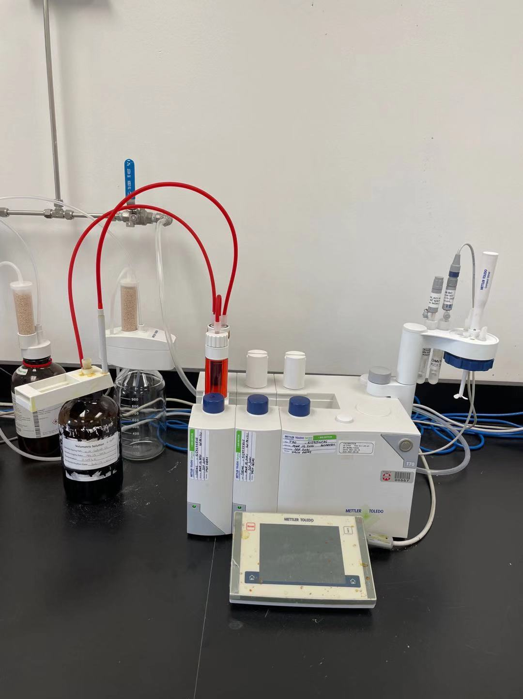
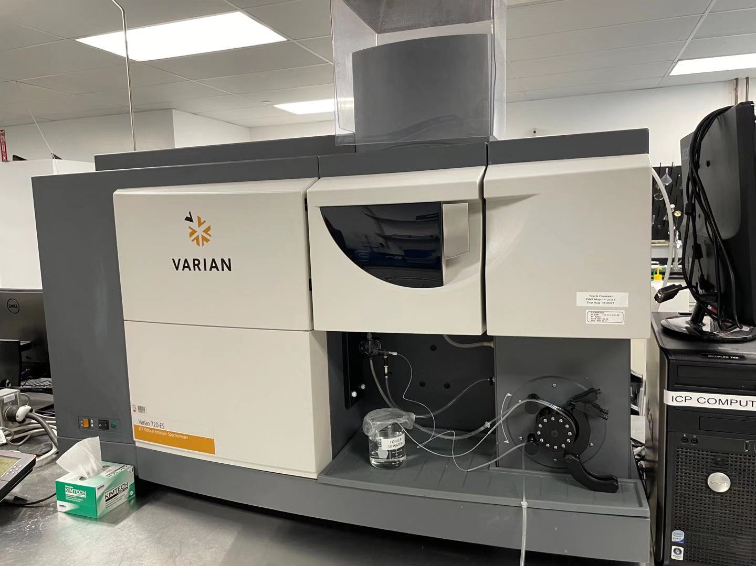
Analytical Chemistry 101
Autotitrator
Inductively Coupled Plasma (ICP)-atomic emission spectrometry
https://www.sciencedirect.com/topics/materials-science/inductively-coupled-plasma-atomic-emission-spectroscopy
https://en.wikipedia.org/wiki/Titration

Slide 5
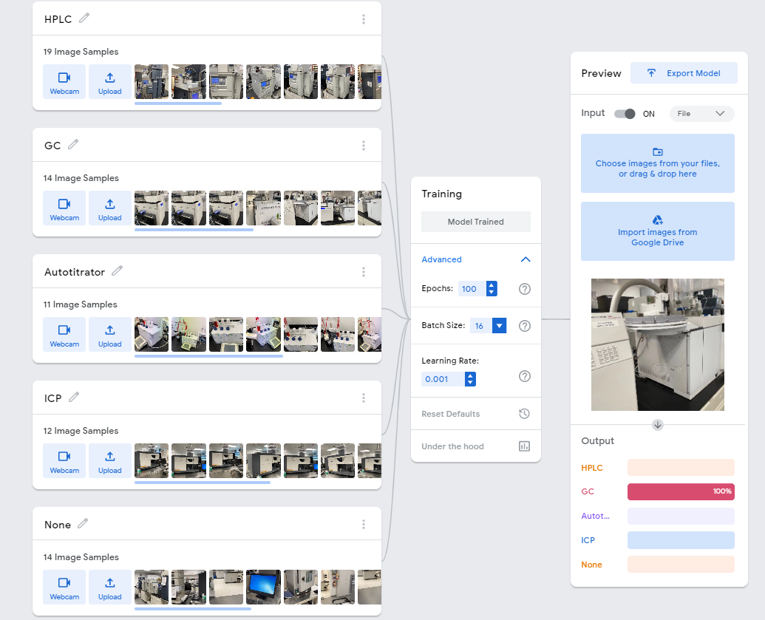

Slide 6

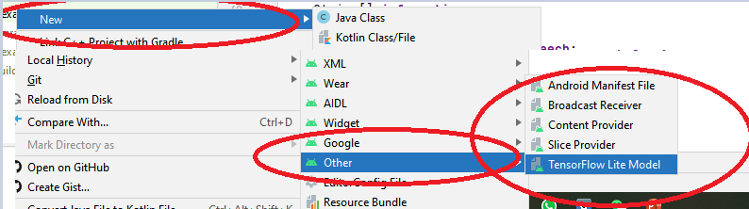
Block Diagram
Home Screen
2
3
1
Select Image from Album
Take a picture
Show Instruction
Not a known device
Model Trained on Google’s Website:
https://teachablemachine.withgoogle.com/
Download and add TensorFlowLite Model in Android Studio
The same way as how to add all the other services with right click:
Recognized by ML
Model saved locally under res\ml folder
Yes
Check Connection to DB
No
Only show Name
This is a Google Firebase RealTime Database
Yes
Show Details from DB
Data saved online with connection check

Slide 7
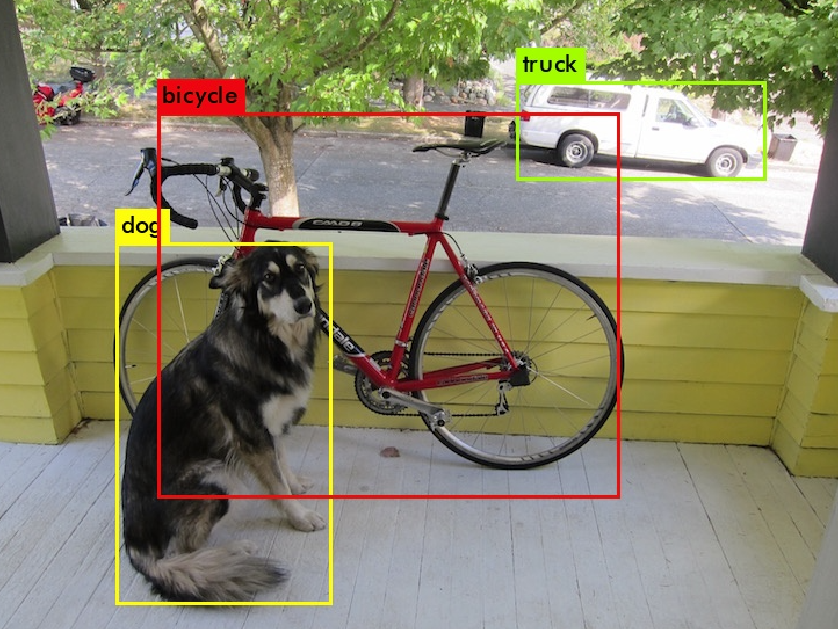
Future work
Import more function
(1) We could build a database to provide equipment management. Add, remove and search function can be used to manage the amount for each equipment in the factory.
(2) We could build a virtual building to show how many equipment in which room of the factory or lab. In this function, you could add a room and allocate an equipment to one existed room.
Improve the deep learning model.
(1) The model could be upgraded from image classification
to object detection, which need more training process.
(2) We could provide a real-time detection for the equipment.
The detection will focus a rectangle on the object in the
camera screen and tell the name.

Slide 8

The End.
Thank you!

